Slide 1
Linked List
Mrs. Sonali V. Shinge

Slide 2
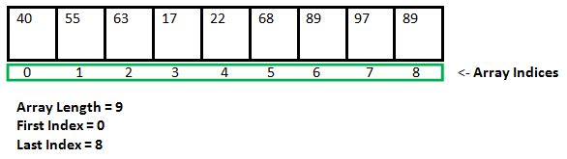
Array: Arrays store elements in contiguous memory locations, resulting in easily calculable addresses for the elements stored and this allows faster access to an element at a specific index.

Slide 3
disadvantages
arrays, the size is given at the time of creation and so arrays are of fixed length.
An array can accommodate similar types of data types
Inefficient insertion and deletion
Implementation of Queue and Deque is complex

Slide 4
Introduction
A linked list is a linear data structure which can store a collection of "nodes" connected together via links i.e. pointers.
Linked lists nodes are not stored at a contiguous location, rather they are linked using pointers to the different memory locations.
A node consists of the data value and a pointer to the address of the next node within the linked list.
It is a dynamic linear data structure whose memory size can be allocated or de-allocated at run time based on the operation insertion or deletion, this helps in using system memory efficiently.
Linked lists can be used to implement various data structures like a stack, queue, graph, hash maps, etc.

Slide 5
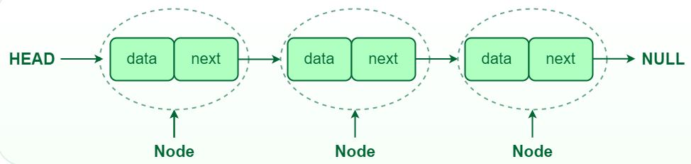
Node Structure: A node in a linked list typically consists of two components:
Data: It holds the actual value or data associated with the node.
Next Pointer or Reference : It stores the memory address (reference) of the next node in the sequence.

Slide 6
Head : The linked list is accessed through the head node, which points to the first node in the list.
Tail : The last node in the list points to NULL or null ptr, indicating the end of the list. This node is known as the tail node.

Slide 7
Types of Linked List
Singly Linked Lists
Doubly Linked Lists
Circular Linked Lists

Slide 8

Singly Linked Lists
Singly linked lists contain two "buckets" in one node; one bucket holds the data and the other bucket holds the address of the next node of the list.
Traversals can be done in one direction only as there is only a single link between two nodes of the same list.

Slide 9

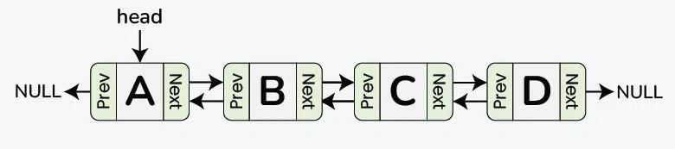
Doubly Linked Lists
OR
Doubly Linked Lists contain three "buckets" in one node; one bucket holds the data and the other buckets hold the addresses of the previous and next nodes in the list.
The list is traversed twice as the nodes in the list are connected to each other from both sides.

Slide 10
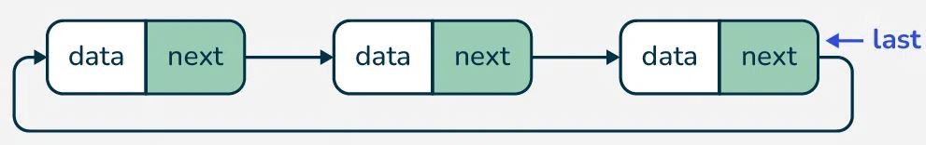
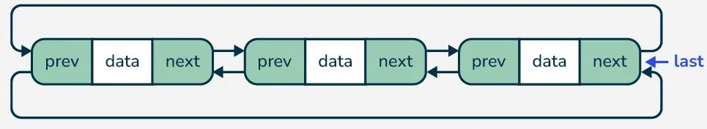
Circular Linked Lists
Circular Singly Linked List
Circular Doubly Linked List
Circular linked lists can exist in both singly linked list and doubly linked list.
The last node and the first node of the circular linked list are connected, the traversal in this linked list will go on forever until it is broken.

Slide 11
Basic Operations in Linked List
Insertion − Adds an element in the list.
Deletion − Deletes an element from the list.
Display − Displays the complete list.
Search − Searches an element using the given key.

Slide 12
Insertion at Begin
Algorithm:
START
Create a node to store the data
Check if the list is empty
If the list is empty, add the data to the node and assign the head pointer to it.
If the list is not empty, add the data to a node and link to the current head. Assign the head to the newly added node.
END

Slide 13
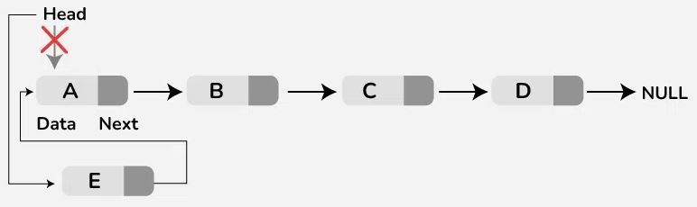

Slide 14
Insertion at End
Algorithm:
START
Create a new node and assign the data
Find the last node
Point the last node to new node
END

Slide 15
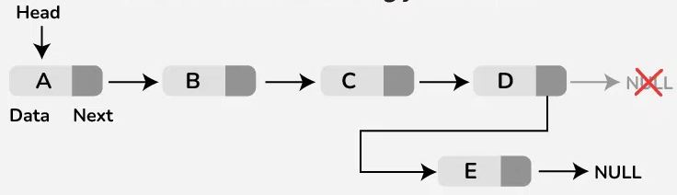

Slide 16
Insertion at a Given Position
Algorithm:
START
Traverse the Linked list upto position-1 nodes.
Once all the position-1 nodes are traversed, allocate memory and the given data to the new node.
Point the next pointer of the new node to the next of current node.
Point the next pointer of current node to the new node.
END

Slide 17
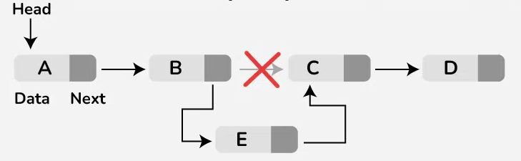

Slide 18
Deletion at Beginning
Algorithm:
Check if the list is empty: If the head is NULL, the list is empty, and there’s nothing to delete.
Update the head pointer: Set the head to the second node (head = head->next).
Delete the original head node: The original head node is now unreferenced, and it can be freed/deleted if necessary.

Slide 19
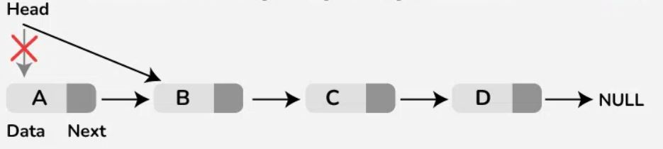

Slide 20
Deletion at End
Algorithm:
Check if the list is empty: If the head is NULL, the list is empty, and there’s nothing to delete.
If the list has only one node: Simply set the head to NULL (the list becomes empty).
Traverse the list to find the second-last node: Start from the head and iterate through the list until you reach the second-last node (where the next of the node is the last node).
Update the next pointer of the second-last node: Set the second-last node’s next to NULL (removing the link to the last node).
Delete the last node: The last node is now unreferenced and can be deleted or freed, depending on the language used.

Slide 21
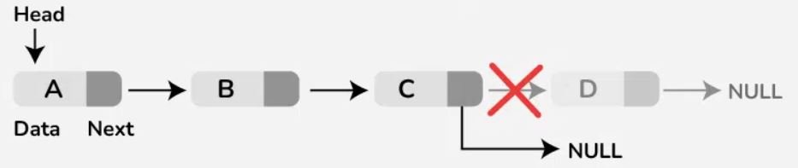

Slide 22
Deletion at a Given Position
Algorithm:
Check if the position is valid: If the position is out of bounds (greater than the length of the list), return an error or handle appropriately.
Traverse the list to find the node just before the one to be deleted: Start from the head and move through the list until reaching the node at position n-1 (one before the target position).
Update the next pointer: Set the next pointer of the (n-1)ᵗʰ node to point to the node after the target node (node_to_delete->next).
Delete the target node: The node to be deleted .

Slide 23
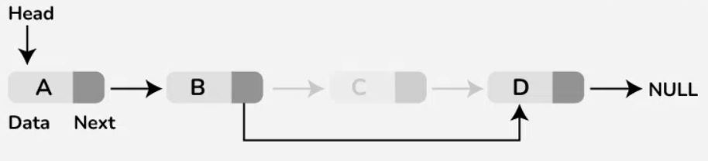

Slide 24
Search Operation
Algorithm:
START
If the list is not empty, iteratively check if the list contains the key
If the key element is not present in the list, unsuccessful search
END

Slide 25
Traversal Operation
Algorithm:
START
While the list is not empty and did not reach the end of the list, print the data in each node
END

Slide 26
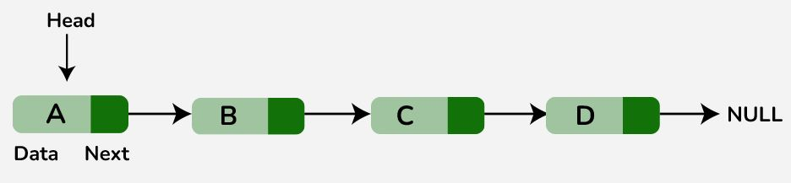

Slide 27
Linked list implementation of stack
In linked list implementation of stack, the nodes are maintained non-contiguously in the memory.
Each node contains a pointer to its immediate successor node in the stack.
Stack is said to be overflown if the space left in the memory heap is not enough to create a node.
The top most node in the stack always contains null in its address field.

Slide 28
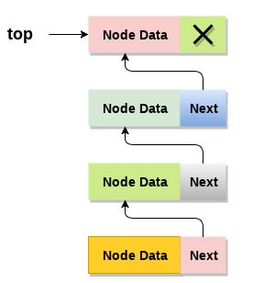

Slide 29
Push Operation
Algorithm:
Create a node first and allocate memory to it.
If the list is empty then the item is to be pushed as the start node of the list. This includes assigning value to the data part of the node and assign null to the address part of the node.
If there are some nodes in the list already, then we have to add the new element in the beginning of the list (to not violate the property of the stack). For this purpose, assign the address of the starting element to the address field of the new node and make the new node, the starting node of the list.

Slide 30
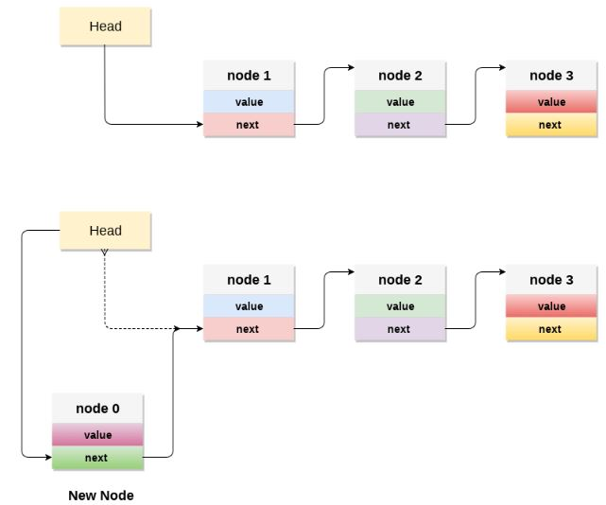

Slide 31
POP operation
Algorithm:
Check for the underflow condition: The underflow condition occurs when we try to pop from an already empty stack. The stack will be empty if the head pointer of the list points to null.
Adjust the head pointer accordingly: In stack, the elements are popped only from one end, therefore, the value stored in the head pointer must be deleted and the node must be freed. The next node of the head node now becomes the head node.

Slide 32
Traversing
Algorithm:
Copy the head pointer into a temporary pointer.
Move the temporary pointer through all the nodes of the list and print the value field attached to every node.

Slide 33

Linked List implementation of Queue
In a linked queue, each node of the queue consists of two parts i.e. data part and the link part. Each element of the queue points to its immediate next element in the memory.
In the linked queue, there are two pointers maintained in the memory i.e. front pointer and rear pointer. The front pointer contains the address of the starting element of the queue while the rear pointer contains the address of the last element of the queue.
Insertion and deletions are performed at rear and front end respectively. If front and rear both are NULL, it indicates that the queue is empty.

Slide 34
Doubly Linked List (DLL)

Slide 35
A doubly linked list is a more complex data structure than a singly linked list, but it offers several advantages.
The main advantage of a doubly linked list is that it allows for efficient traversal of the list in both directions.
This is because each node in the list contains a pointer to the previous node and a pointer to the next node.
This allows for quick and easy insertion and deletion of nodes from the list, as well as efficient traversal of the list in both directions.

Slide 37
Creation of DLL
Algorithm:-
1. start
2. Create a Node structure:
Each node should have three fields:
data (to store the value),
prev (pointer to the previous node),
next (pointer to the next node).
3. Initialize the head:
Start with head = NULL (empty list).
Create a new node.
4. If head is NULL:
Set head to new node.
Else:
Traverse to the last node.
Update last node’s next to point to the new node.
Update new node’s prev to point to the last node.
5. End

Slide 38
Insertion at the Beginning
Algorithm:-
1. START
2. Create a new node with three variables: prev, data, next.
3. Store the new data in the data variable
4. If the list is empty, make the new node as head.
5. Otherwise, link the address of the existing first node to the
next variable of the new node, and assign null to the prev variable.
6. Point the head to the new node.
7. END

Slide 39
Insertion at the End
Algorithm:-
1. START
2. If the list is empty, add the node to the list and point
the head to it.
3. If the list is not empty, find the last node of the list.
4. Create a link between the last node in the list and the
new node.
5. The new node will point to NULL as it is the new last node.
6. END

Slide 40
Deletion at the Beginning
Algorithm:-
1. START
2. Check the status of the doubly linked list
3. If the list is empty, deletion is not possible
4. If the list is not empty, the head pointer is
shifted to the next node.
5. END

Slide 41
Circular Linked List (CLL)
A circular linked list is a data structure where the last node connects back to the first, forming a loop.
This structure allows for continuous traversal without any interruptions.
Circular linked lists are especially helpful for tasks like scheduling and managing playlists, allowing for smooth navigation.

Slide 42
Circular Singly Linked List
Circular Doubly Linked List

Slide 43
Insertion at begin
Algorithm:-
START
Create a new node with the given value.
Check Empty List (last == nullptr):
Make newNode->next point to itself.
Insert at Beginning:
Set newNode->next to last->next.
Update last->next to newNode.
END

Slide 44
Insertion at end
Algorithm:-
Create a new node with the given value.
Check Empty List, If last is nullptr then initialize the list with the new node and make it point to itself.
Otherwise, Set the new node's next to the head node.
Update the current last's next to point to the new node.
Update last to the new node.

Slide 45
Deletion at begin
Algorithm:-
Check if List is Empty:
If last is nullptr, print “List is empty” and return nullptr.
Get Head Node:
Set head to last->next.
Check for Single Node:
If head equals last, delete head and set last to nullptr.
Handle Multiple Nodes:
Update last->next to point to head->next.
Delete head.
Return Updated last

Slide 46
Deletion at end
Algorithm:-
Check if List is Empty (last is nullptr) then print “List is empty, nothing to delete” and return nullptr.
Get head node by Setting head to last->next.
Check for single node, if head equals last, delete last and set last to nullptr.
Find second last node by traversing the list until curr->next equals last.
Update Pointer by setting curr->next to point to head.
Delete last and update last to curr.
Return the updated last.

Slide 47
Application of Linked List
Memory Management
Implementing Stacks and Queues
Web Browsers (History Tracking)
Graph Representation
Polynomial Arithmetic
Circular Linked Lists in Round-Robin Scheduling
Sparse Matrix Representation
String Manipulation

Slide 48
Application of Linked List
Real-Time Gaming Applications
Queue Management in Simulations
Text Editor Buffers
Undo and Redo Functionality
Real-Time Event Handling
Database Management Systems
File Systems and Directory Management
Music Playlist Management

